Slide 1
Use of language

Slide 2
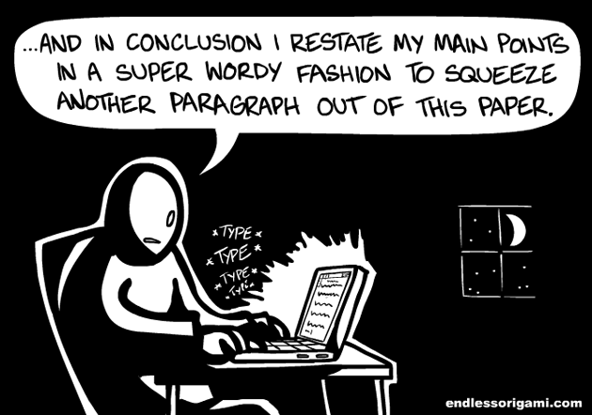
Use of language
Notes:
Writing Style is important to your work's readability. A report that contains lots of spelling mistakes and grammatical errors is unreadable (regardless of the level of its content)

Slide 3
USE OF LANGUAGE Assessment criteria Rubric
Proper English us used
Ideas of other authors are clearly described in own words
Foreign concepts that are hard to translate are shown in italics
Sentences are clearly formulated (no excessive use of passive voice; variable sentence length - not too many overly long sentences or discontinuous clauses; no overly complex phrasing, not too many noun constructions)
A scientific writing style is used (i.e. formal, objective, carefully phrased, concise, no informal language)
Notes:
Listed above are the style requirements that you'll need to meet.
Your report should not contain any grammatical or spelling errors and should feature correct punctuation.
Your sentences should be clear and made up in your own words.
You should apply a scientific writing style. That doesn't imply that you should resort to using overly complicated language. A scientific writing style may be characterised as: objective, neutral, carefully formulated and clear.

Slide 4
Pitfalls
Complex phrasing
An insufficiently scientific writing style
Grammatical and spelling errors

Slide 5
Scientific writing style
Clear
Objective/Neutral
Carefully formulated
Not unnecessarily complicated
Notes:
Scientific writing means you have to write in an objective, neutral, carefully formulated and clear style, not overcomplicating things.
Clear → Don’t be too easily satisfied with your formulations. Did you really choose the right words? Avoid vague and empty words such as: things, rather, absolutely, or so. Also avoid filler words like: say, of course, quite.
Objective and neutral → Display information without giving your personal opinion. Try to choose words that show no judgment and describe the findings objectively.
Careful → Bring out the nuances where you can. E.g. don't say: "there is a positive relation between…”, but say “this suggests a positive relation between...”)
Don't overcomplicate things → a scientific writing style doesn’t need to feature too many difficult words.

Slide 6
Describing research findings
Name the results, not the opinion of the researchers
Describe results with the right uncertainty level
Be prudent with causal implications when you
are discussing correlations:
NOT: X influences / has an effect on /causes etc.
BUT: relation; association; interrelation
Description in terms of chances and risks

Slide 7
Careful formulations
Write in terms of possible explanations:
Possibly this means ....
It seems that …
This may indicate that …
Differences may be explained by ....

Slide 8
Tip: Use of language
Consult the academic phrasebank if you have difficulty finding the right way to express yourself in academic language
https://www.phrasebank.manchester.ac.uk/

